Slide 1


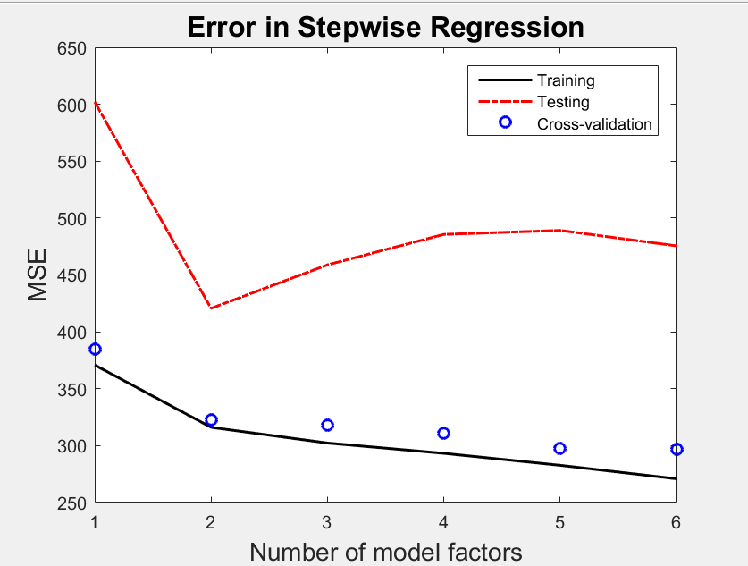
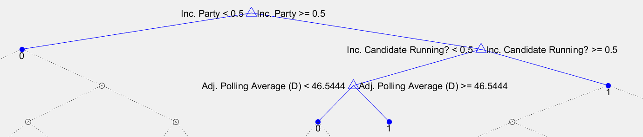
Predictive Modeling of US Senate Elections
Stuart Young and Rubén Agüero
The College of Wooster
Abstract
Methodology
Within the sphere of predictive modeling, election results are increasingly studied and analyzed. While polls can often act as a baseline barometer of a candidate's chances, they sometimes miss the mark; the 2016 presidential election is evidence of this. However, the factors that best predict election results vary based on the type of election. While many have studied Presidential general elections, less attention has been focused on more local elections. We develop a methodology to predict the results of recent Senate elections, using a variety of potential factors. We use both regression and machine learning methodology, and compare the results of each.
Weighted Polling Average
Pollsters with historical accuracy given extra weight
3 Variable Sets
Baseline (Polls-only)
All Variables
Stepwise Regression
  5-fold cross validation
  Optimal 6 variable set
Regression – Vote Margin (%)
Decision Trees – Winning Party (binary)
K-nearest Neighbor – Winning Party (binary)
Figure 2: Error by number of factors
Data
Conclusion
n=250 Senate races from 1998-2014
Independent Variables Dependent Variables
Incumbent Party Running? (binary) Vote Margin (%)
National Unemployment Rate (%) Winning Party (binary)
State Unemployment Rate (%)
Median Income (nominal $)
Relative Median Income (proportion)
Incumbent Party (binary)
Election Year Type (binary)
Weighted Polling Average (Dem.) (%)* *polling data from
Weighted Polling Average (Rep.) (%)* FiveThirtyEight
Party of the Sitting President (binary)
National Presidential Approval Rate (%)
 | Baseline (Polls only) | Full | Stepwise
Regression | 453.7 | 298.4 | 303.8
Decision Trees | 0.105 | 0.040 | 0.061
K-nearest Neighbor (1) | 0.03 | 0 | 0
The regression MSEs show the difficulty of predicting vote percentage for Senate elections. The relatively large MSEs indicate potentially missing explanatory variables in the model. The addition of more variables improved the regression model MSEs. The MSEs of the machine learning techniques reflect that binary outcomes are relatively easier to predict with significant accuracy. Future research should focus on determining which additional factors improve model accuracy, including the use of refined pollster ratings.
Table 1: MSE for each model
References
1. Silver, N. (2014). How the fivethirtyeight senate forecast model work
2. Lewis-Beck, M. S. and Rice, T. W. (1992). Forecasting elections
3. Draper, N. R. and Smith, H. (1998). Applied Regression Analysis. WileyInterscience, 3rd edition
Figure 1: Pruned decision tree

Slide 2

Bach Chorales and Predictive Modeling
Nicholas Czaban

